Slide 1
LADIES WEAR
BOTTOM

Slide 2
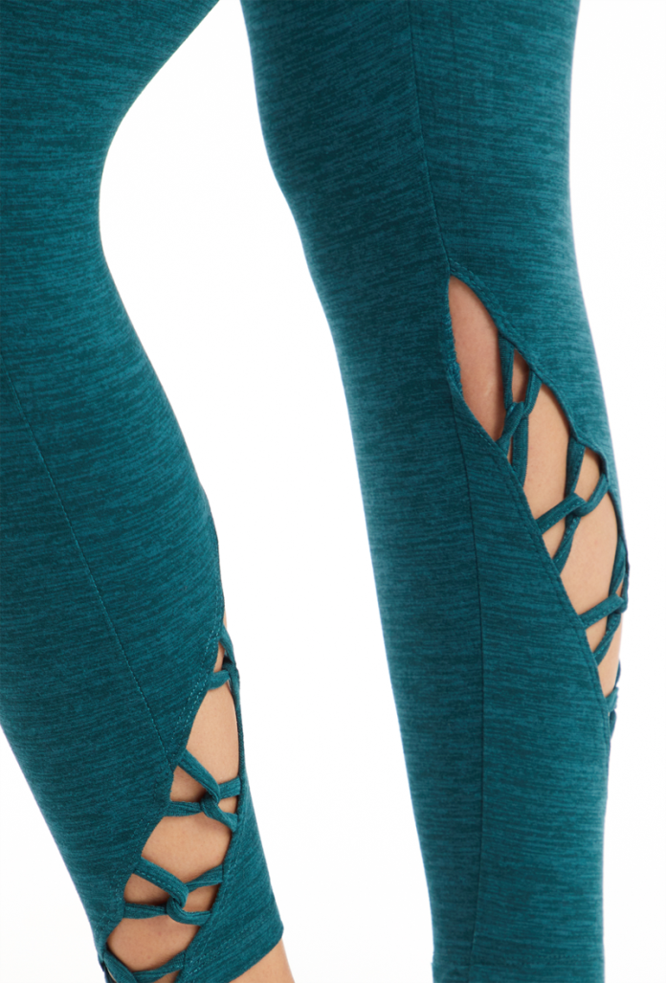
Cruz Ankle Legging
Solid: 90% Polyester, 10% Spandex Heather: 88% Polyester, 12% Spandex
Cozy Jersey
Cut Out With Strap Detail Back To Front
Media Pocket At Inner Waistband
Coolmax Gusset

Slide 3
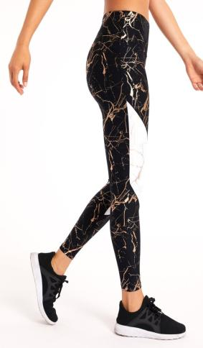
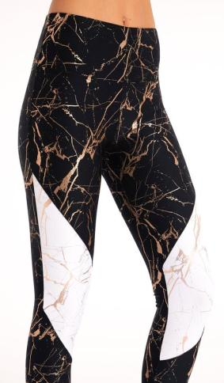
Dana Ankle Legging
90% Polyester, 10% Spandex
Polyester Spandex Powertek
Foil Print
Contrast Print Piecing
Coolmax Gusset
Moisture Performance
Dry-Wik, PWR-Tek

Slide 4
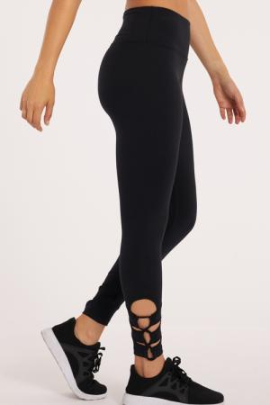
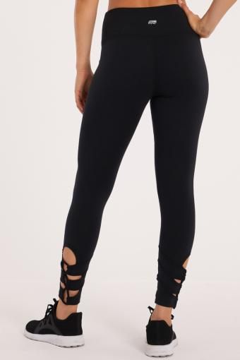
Josie Cut Out Ankle Legging
90% Polyester, 10% Spandex
Soft Breathable Fabric
Cut Out With Strap Detail At Hems
Media Pocket At Inner Waistband
Coolmax Gusset
Sanded Dry-Wik

Slide 5
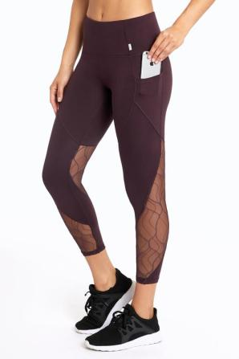
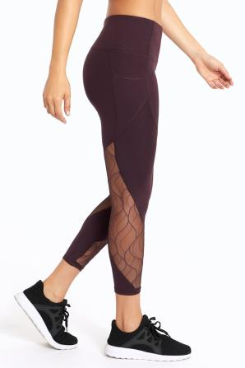
Arabella Tummy Control Side Pocket Ankle Legging
92% Polyester, 8% Spandex
4 Way Stretch Brushed Interlock Jersey
Side Pockets
Waistband With Powermesh Lining For Tummy Control
Pattern Mesh Insets
Contour Style Lines
Coolmax Gusset
INTERLOK, Dry-Wik

Slide 6
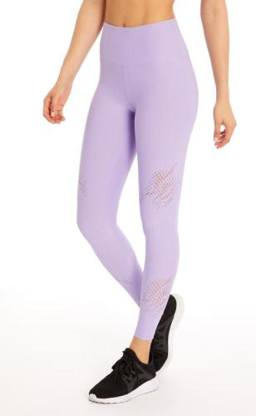
Marissa Laser Cut Ankle Legging
90% Polyester, 10% Spandex
Light Weight Powertek Jersey
Laser Cut Design Placement At Front
Media Pocket At Inner Waistband
Moisture Performance, Coolmax Gusset
PWR-Tek

Slide 7
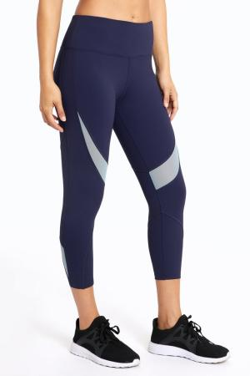
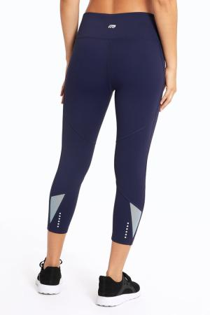
Oasis Capri
83% Nylon, 17% Spandex
360 Light Warp Jersey For Compression & Contouring
Contrast Mesh Insets
Reflective Heat Transfers At Back Hem
Inner Waistband Drawcord For Extra Support
Media Pocket At Inner Waistband
Coolmax Gusset
SKIN360, Dry-Wik

Slide 8
Mid Calf Capri Legging
92% Polyester, 8% Spandex
4 Way Stretch Interlock Jersey
Tie Dye & Mesh Insets
Contour Style Lines
Media Pocket At Inner Waistband
Moisture Performance
Coolmax Gusset
INTERLOK, Dry-Wik

Slide 9
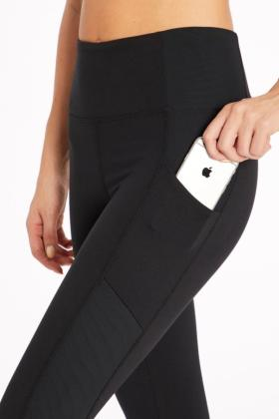
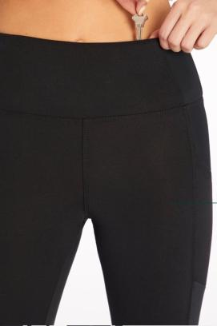
Hunter Slimming Side Pocket Mid Calf Capri
87% Polyester, 13% Spandex
2 Way Stretch Brushed Jersey
Side Pockets
Cover Stitch Seam Detail
Powermesh Lining At Side Seams For Slimming Effect
Media Pocket At Inner Waistband
Coolmax Gusset
Duo-Flex, Dry-Wik

Slide 10
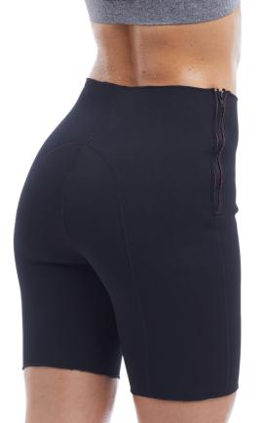
Compression Short With Pocket
Neoprene
Extra Support For Glutes & Thighs
Wear Over Or Under Clothing
Side Zipper For Easy Entry
Assists In Generating Heat To Burn Extra Calories & Promote Weight Loss
Shed Excess Water Weight
Slims & Trims, Smooth Sillhouette
Hand Wash Cold With Mild Soap, Hang Dry
Flexible & Durable

Slide 11
Raven Mesh Running Short
90% Polyester, 10% Spandex
Light Weight Powertek Jersey
Printed Inner Short With Open Hole Mesh Overlay
Elastic Encased Waistband
Moisture Performance, Coolmax Gusset
PWR-Tek

Slide 12
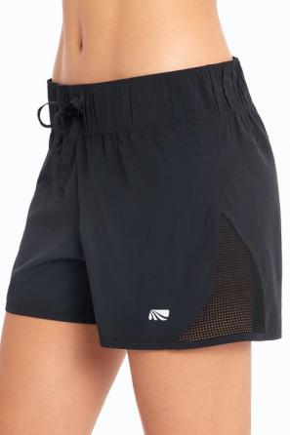
Jaime Run Short
90% Polyester, 10% Spandex
Stretch Woven
Mesh Insets At Hem
Shirred Waistband
Elastic Drawcord
Moisture Performance
Dry-Wik

Slide 13
Annika Skort
Solid: 90% Polyester, 10% Spandex Heather: 76% Polyester, 24% Spandex
Soft Breathable Fabric With Moisture Performance
Jacquard Mesh Overlay At Back
Media Pocket At Inner Waistband
Coolmax Gusset On Inner Short
Sanded Dry-Wik

Slide 14
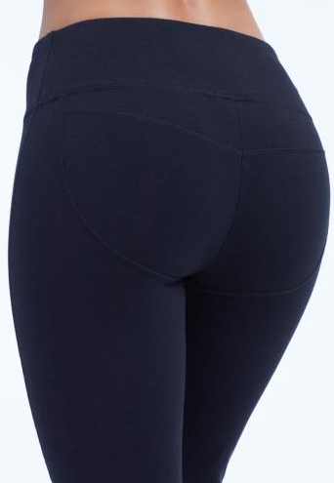
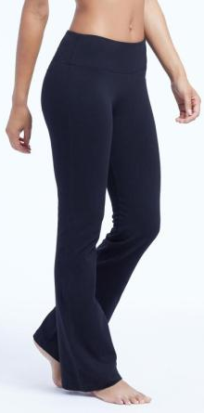
Audrey Butt Booster Pants
89% Cotton,11% Spandex
Cotton Spandex Jersey
Contouring Seaming Enhances Your Behind
Coolmax Gusset
Moisture Performance
Semi-Fitted Straight Leg
32" Inseam

Slide 15
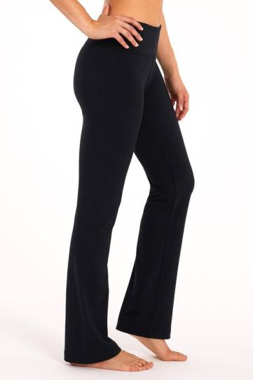
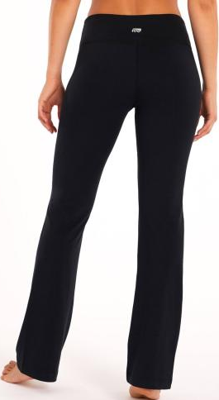
Barely Flare 34" Pants
90% Polyester, 10% Spandex
Soft Breathable Fabric
Moisture Performance
Coolmax Gusset
17" Leg Opening Circumference
Sanded Dry-Wik

Slide 16
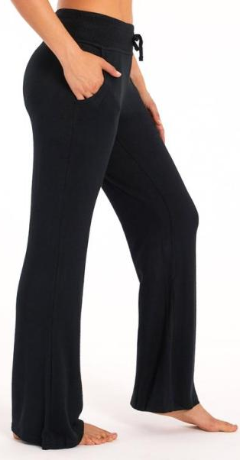
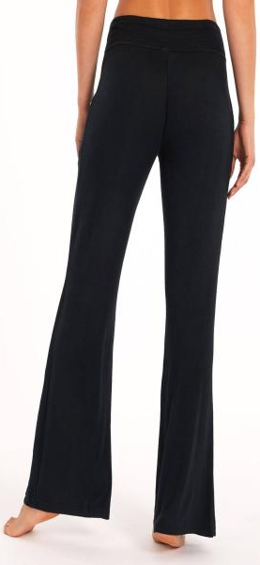
Willow Pant
74% Rayon, 22% Polyester, 4% Spandex
Hacci Brushed Knit
Front Pockets
Rib Knit Waistband With Drawcord
Wide Leg Opening

Slide 17
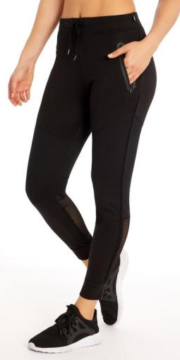
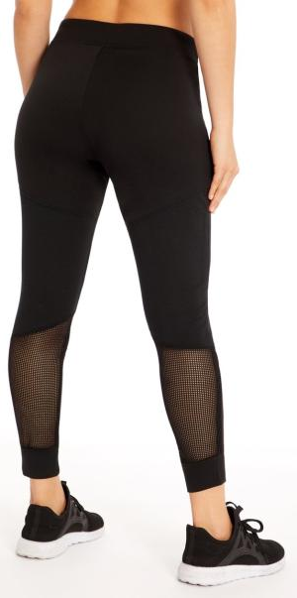
Jaxon Jogger
70% Polyester, 26% Rayon, 4% Spandex
Light Weight French Terry
Barricate Knit & Mesh Piecing
Side Pockets With Bonded Zipper
Elastic Encased Waistband With Functional Drawcord
Cuffed Hems

Slide 18
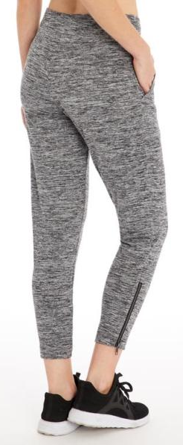
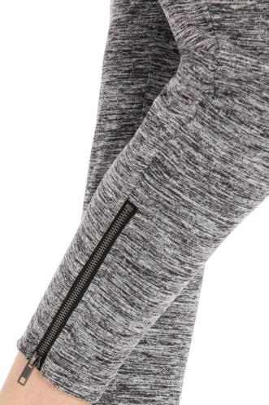
Raven Jogger
88% Polyester, 12% Spandex
Heather Jersey
Front Pockets
Zipper At Leg Opening

Slide 19
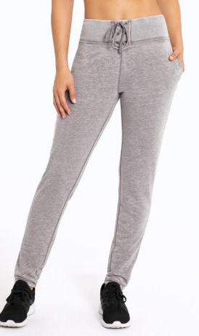
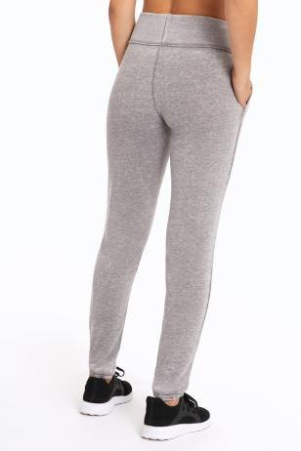
River Jogger
50% Polyester, 38% Cotton, 12% Rayon
Enzyme Wash French Terry
Slash Side Pockets
2 X 2 Rib Elastic Encased Waistband
Drawstring & Grommet Detail
Cuffed Hems

Slide 20
TOPS

Slide 21
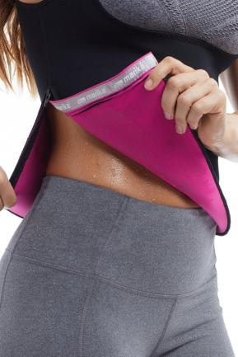
Compression Tank Top
Neoprene
Tummy, Back & Obliques Support
Wear Over Or Under Clothing
Side Zipper For Easy Entry
Assists In Generating Heat To Burn Extra Calories & Promote Weight Loss
Slims & Trims, Smooth Sillhouette
Flexible & Durable

Slide 22
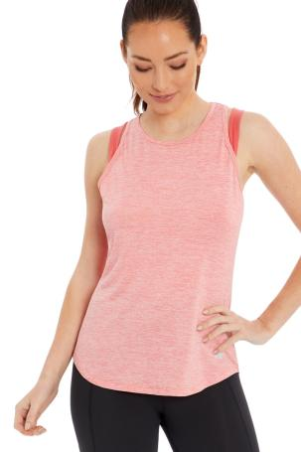
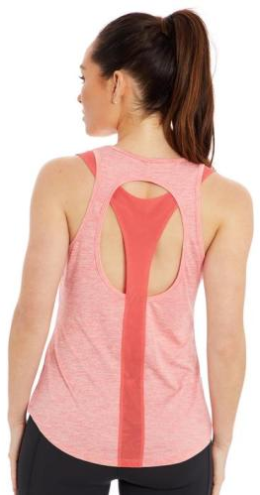
Mari Singlet
93% Polyester, 7% Spandex
Heather JerseyHigh Crew Neck
Mesh Piecing
Keyhole Detail At Back
Racerback Style
No Inner Shelf Lining
Dry-Wik

Slide 23
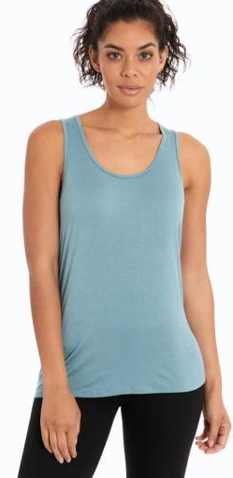
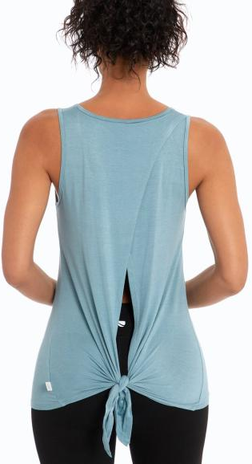
Avaya Tank
95% Rayon, 5% Spandex
Jersey
Scoopneck
Sleeveless
Cross Over Open Back
No Inner Shelf Lining

Slide 24
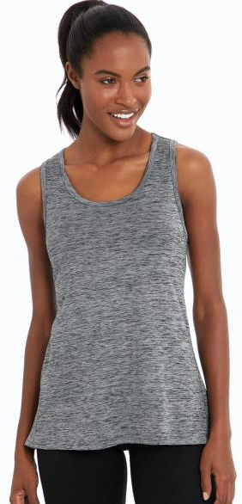
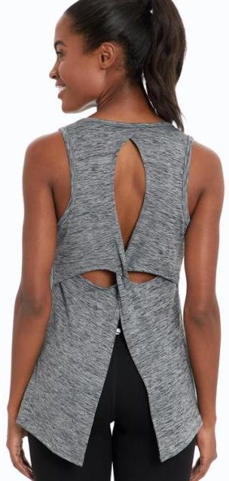
Nicole Singlet
95% Polyester, 5% Spandex
Heather Jersey
Scoop neck
Twist With Keyhole Opening At Back
Split Hem At Back
No Inner Shelf Lining

Slide 25
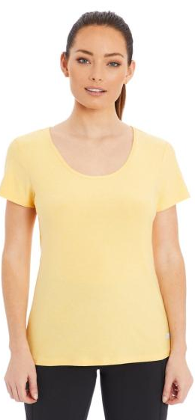
Kenwood Tee
90% Polyester, 10% Spandex
Stretch Jersey
Scoop neck
Short Sleeves
Mesh Panel At Back
Strap & Drape Detail At Center Back
High-Low Hemline
Dry-Wik

Slide 26
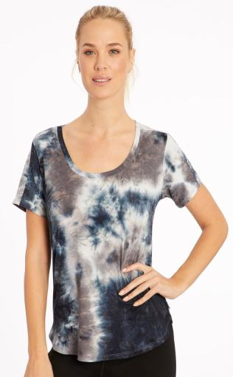
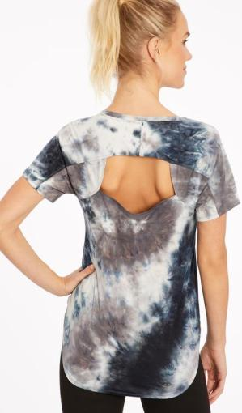
Dorinda Tee
94% Polyester, 6% Spandex
Tie Dye Jersey
Scoopneck
Short Sleeves
Keyhole Detail At Back
Contour Seams
Machine Wash
Loose Fit
26" Length

Slide 27
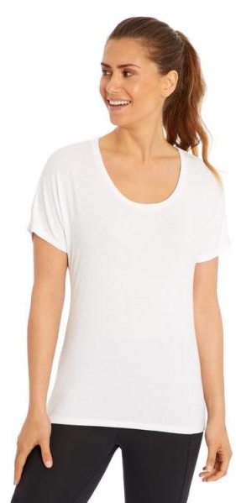
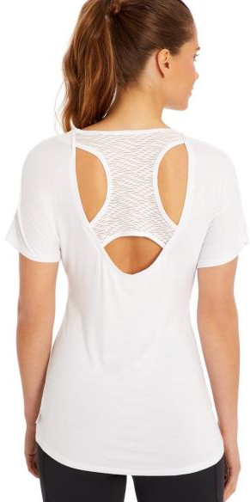
Blaze Tee
95% Rayon, 5% Spandex
Jersey
Scoopneck
Short Sleeves
Cut Out Pattern Mesh Detail At Back, High-Low Hemline

Slide 28
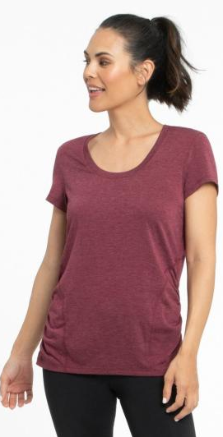
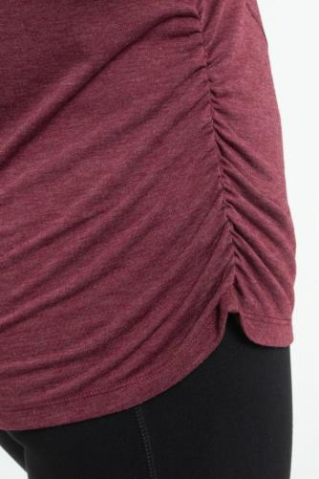
Brittany Shape Enhancing Tee
87% Polyester, 10% Rayon, 3% Spandex
Heather Jersey
Scoop Neck
Short Sleeve
Forward Set Side Seams
Back Racerback Seam Detail
Shirring At Sides
Dry-Wik

Slide 29
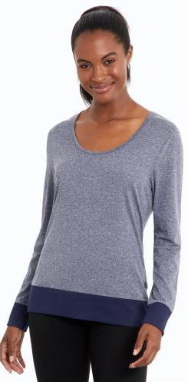
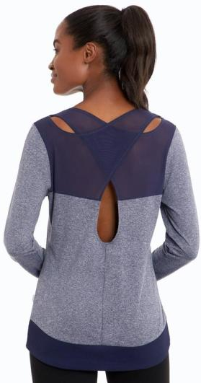
Carisa Long Sleeve Tee
90% Polyester, 10% Spandex
Heather Jersey
Scoopneck
Long Sleeves
Mesh Cross Over Panels With Keyhole Detail At Back
Rib Knit Cuffs & Hem Band

Slide 30
JACKETS

Slide 31
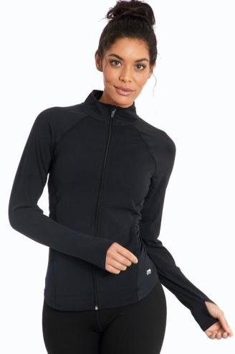
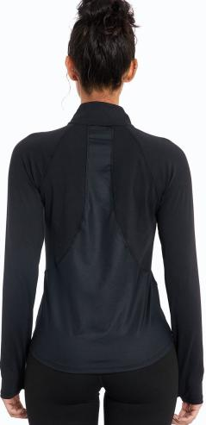
Renewal Jacket
Details:
90% Polyester, 10% Spandex
Soft Breathable Fabric
Long Sleeve With Thumbhole
Full Zip Up
Chintz Jersey Fabric At Side Seam Insets
Side Pockets
Machine Wash
Fitted
26" Length
Sanded Dry-Wik

Slide 32
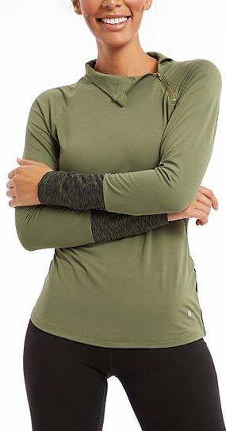
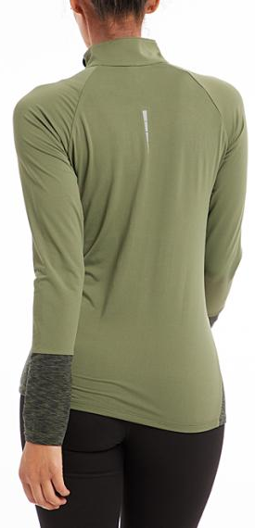
Frost Asym ¼ Zip Jacket
90/10 Polyester Spandex, Wicking With Back Side Brush
Long Sleeve
¼” Zip Up

Slide 33
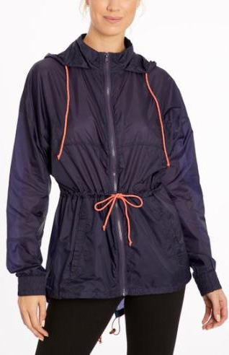
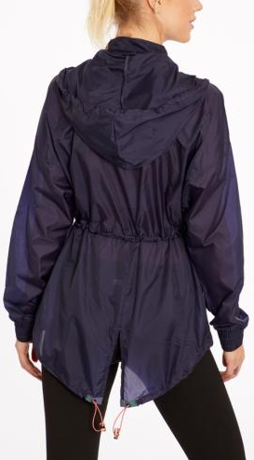
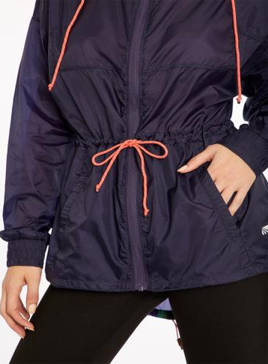
Stella Jacket
100% Nylon Taffeta
Long Sleeve
Full zip up

Slide 34
HOODIES

Slide 35
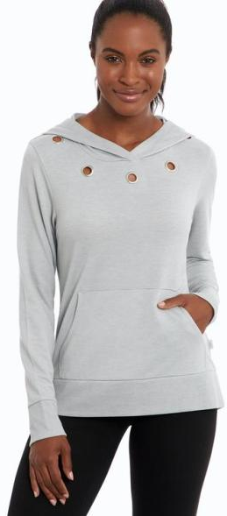
Amora Hoodie
90% Polyester, 10% Rayon
French Terry
Long Sleeves
Cuffed Rib Knit Sleeves & Hemband
Grommet Detail At Front Neckline
Kangaroo Pocket
Hood

Slide 36
Contrast Cowl Hoodie
90% Polyester, 10% Spandex
Wicking
Back Side Brush
Tek Fleece
Long Sleeves
Hood

Slide 37
Faded Hoodie
90% Polyester, 7% Rayon, 3% spandex
French Terry
Long Sleeves
Hood

Slide 38
COVER UP

Slide 39
Julianne Cover-up
100% Polyester
Striped Chiffon
V-Neck
Pull Over Style
Strap Loop Detail At Center Front
Short Sleeves

Slide 40
Mary Printed Cover-up
100% Polyester
Printed Chiffon
Front Opening
Functional Drawstring
Short Sleeves

Slide 41
Jenna Cover-up
100% Polyester
Jersey
Deep V-Neck
Strappy Detail At Front
Racerback Style

Slide 42
SWEATSHIRT

Slide 43
George Femme
65% Polyester 35% Cotton
Long Sleeve
Glitter Print

Slide 44
Terranova
60% Cotton 40% Polyester
Long Sleeve
Applique Embroidery

Slide 45
INTIMATES

Slide 46
Long Line Push Up Convertible Bra
91% Poly 9% Span

Slide 47
Multi way Convertible push up
91% Poly 9% Span
Galloon Lace

Slide 48
Multi Way Convertible Push Up Recover
91% Poly 9% Span
Allover Lace
Galloon Lace

Slide 49
Front Close Sports Bra
95% cotton jersey 5% spandex
Wireless, stretch cups are lined and gently shape and support.
Ruching at center front adds shape.
Covered elastic under band provides added support.
Center front coated metal hook-and-eye closure.

Slide 50
Pullover Sport Bra
95% cotton 5% spandex
Full coverage in a pull-over style. Smoothing 2-ply stretch construction.

Slide 51
Ultra Flex 2-pack Crop Top Low-Impact Sports Bra
58/39/3 Nylon, polyester, spandex
High recovery stretch
Fabric with wicking properties draws moisture away
Flat and soft stitches
Racerback style straps

Slide 52
BIKINI PANTY
84% Polyamide 16%elastane
Low-Rise
Moderate Coverage

Slide 53
Lace Bikini
95% Polyamide, 5% Spandex
•Lace body
•Medium back coverage
•Soft elasticated waist
•Cotton gusset
•Low rise

Slide 54
Lisa Panty
88% Polyamide, 12% Elastane; Lining: 100% Cotton
Sheer mesh detail
Cotton crotch
Full coverage

Slide 55
Lace Thong
89% Polyamide 9% Elastan 2% Cotton
Ultra soft, wide stretch lace band with seamless crotch panel
Lined gusset

